Slide 1
Welcome, I appreciate you for coming
Dr. Myers is setting up for today.
If you have a specific music request, please don’t hesitate to make your preference known.
I want to talk on the videos Key video will be sent to your email shortly.
We’ll do audio and video check just before we start.
1-1

Slide 2
Videos for Today
Brand tracking – Explained!
https://www.youtube.com/watch?v=ZbPUi247wI8
Terri Goldstein - Speaking Brand Intelligence™
https://www.youtube.com/watch?v=6kS3fzdk9N0
color shape symbol
Why You Should Be Building Brand Equity
https://www.youtube.com/watch?v=geaV_bFR_Rk&t=128s
1-2
Notes:
Chap 10
Brand tracking – Explained!
https://www.youtube.com/watch?v=ZbPUi247wI8
Terri Goldstein - Speaking Brand Intelligence™
https://www.youtube.com/watch?v=6kS3fzdk9N0
color shape symbol
Why You Should Be Building Brand Equity
https://www.youtube.com/watch?v=geaV_bFR_Rk&t=128s

Slide 3
Videos for Today
Line Extension vs Brand extension
https://www.youtube.com/watch?v=DaeA-22I-94
Learn How Brand Extension Can Transform Your Business!
https://www.youtube.com/watch?v=pK9rbuX2RuA&t=13s
1-3
Notes:
Chap 10
Brand tracking – Explained!
https://www.youtube.com/watch?v=ZbPUi247wI8
Terri Goldstein - Speaking Brand Intelligence™
https://www.youtube.com/watch?v=6kS3fzdk9N0
color shape symbol
Why You Should Be Building Brand Equity
https://www.youtube.com/watch?v=geaV_bFR_Rk&t=128s

Slide 4
Zoom Items for Presentation
Everyone stays on mute while the presenter is speaking.
Instead of directly interrupting the host, people can ‘raise’ their hand on the virtual platform if they wish to speak. I do prefer you speak when you have opinions. Let’s be concise so we can move through the agenda.
Request your audience members to limit any distraction on their end. This could be due to background noise, kids, pets, social media, or another family member.
1-4
Notes:
Everyone stays on mute while the presenter is speaking.
Instead of directly interrupting the host, people can ‘raise’ their hand on the virtual platform if they wish to speak. I do prefer you speak when you have opinions. Let’s be concise so we can move through the agenda.
Request your audience members to limit any distraction on their end. This could be due to background noise, kids, pets, social media, or another family member.
Apart from this, make sure that you run technical checks and prepare for any possible problems. For example, close down all unnecessary tabs if you’ll be using screen sharing features.

Slide 5
AGENDA
LT1
Some questions were missed, please answer all questions for your choice of the brand. Details, details, details.
Spreadsheets need more detail….we are looking for BOTH CORROBORATION OR DIFFERENTIATION
RP1
Great feedback. The important point is to have some important takeaways for you and your analyses (on the job or for your own individual business)
Notes:
Understanding the current and desired brand knowledge structures of consumers is vital to effectively building and managing brand equity, but it is not possible to build mental maps to understand exactly what exists in consumers’ minds.
“If we knew what were doing it wouldn’t be called research.” - Albert Einstein

Slide 6
AGENDA
LT2
RP2
Ch 10, Importance of research can’t be over emphasized or stressed, enough. We need to know our consumers.
Qualitative Methods
Quantitative Methods
What is the difference in those 2?
Ch 13, New Products and Brand Extensions, The life blood of any business is the new products and services….we have to launch something new every so often
Ansoff Growth Matrix
Extensions and New Product Acceptance
Notes:
Understanding the current and desired brand knowledge structures of consumers is vital to effectively building and managing brand equity, but it is not possible to build mental maps to understand exactly what exists in consumers’ minds.
“If we knew what were doing it wouldn’t be called research.” - Albert Einstein

Slide 7
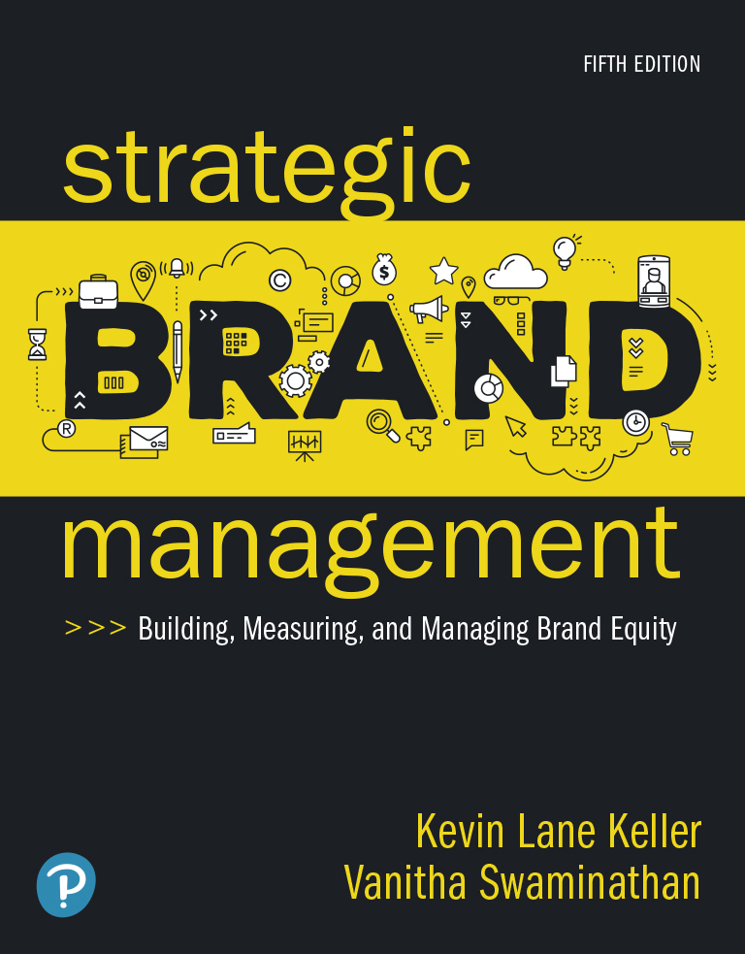
Strategic Brand Management: Building, Measuring, and Managing Brand Equity
Fifth Edition
Chapter 10
Measuring Sources of Brand Equity: Capturing Customer Mind-Set
Copyright © 2020, 2013, 2008 Pearson Education, Inc. All Rights Reserved

Slide 8
Figure 10-1: Understanding Consumer Behavior
Who buys our product or service?
Who makes the decision to buy the product?
Who influences the decision to buy the product?
How is the purchase decision made? Who assumes what role?
What does the customer buy? What needs must be satisfied?
Why do customers buy a particular brand?
Where do they go or look to buy the product or service?
When do they buy? Any seasonality factors?
What are customers’ attitudes toward our product?
What social factors might influence the purchase decision?
Does the customers’ lifestyle influence their decisions?
How is our product perceived by customers?
How do demographic factors influence the purchase decision?
Notes:
This figure presents general considerations in understanding consumer behavior.

Slide 9
Tips
Effective brand management requires us to thoroughly understand the consumer — how consumers think of or use products and the particular brands in a category.
1-9

Slide 10
Videos for Today
Terri Goldstein - Speaking Brand Intelligence™
https://www.youtube.com/watch?v=6kS3fzdk9N0
color shape symbol
1-10

Slide 11
Qualitative Research Techniques
Free Association
Projective Techniques
Zaltman Metaphor Elicitation Technique
Neural Research Methods
Brand Personality and Values
Ethnographic and Experiential Methods
Notes:
There are many different ways to uncover the types of associations linked to the brand and their corresponding strength, favorability, and uniqueness. Qualitative research techniques often identify possible brand associations and sources of brand equity. These are relatively unstructured measurement approaches that permit a range of both questions and answers and so can often be a useful first step in exploring consumer brand and product perceptions.

Slide 12
Zaltman Metaphor Elicitation Technique (1 of 2)
Uncovers hidden consumers’ knowledge
“a technique for eliciting interconnected constructs that influence thought and behavior”
construct refers to “an abstraction created by the researcher to capture common ideas, concepts, or themes expressed by customers”

Slide 13
Zaltman Metaphor Elicitation Technique (2 of 2)
Z M E T study starts with a group of participants
Asked in advance to think about the research topic
Collect a set of images from their own sources that represent their thoughts and feelings about the research topic
Bring images with them for a one-on-one interview
When interviews are complete
Researchers identify key themes or constructs, code the data, and assemble a consensus map of the most important constructs

Slide 14
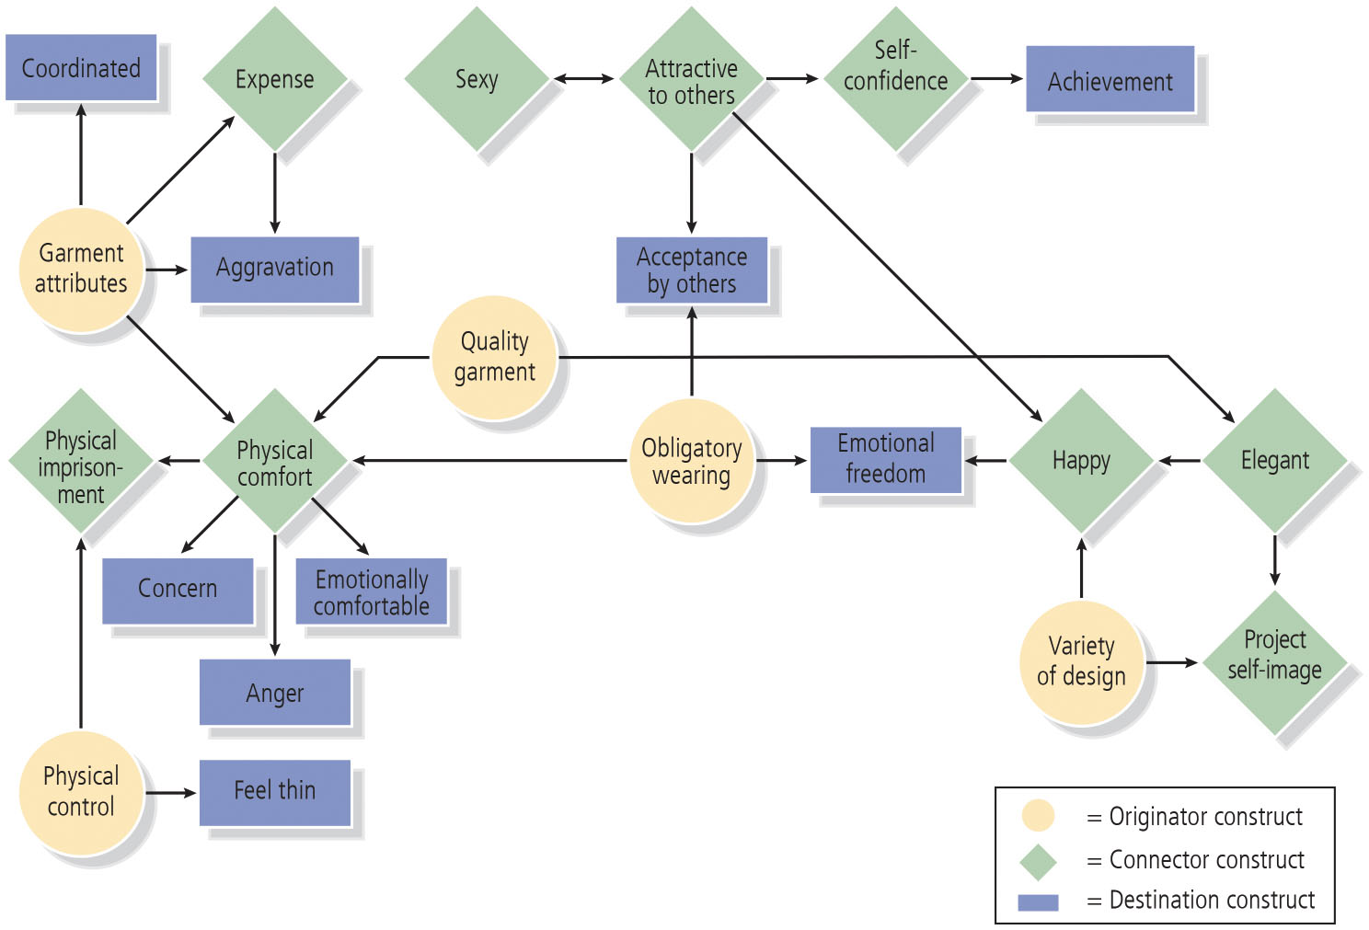
Figure 10-3: Application of Z M E T to Intimate Apparel Market

Slide 15
Quantitative Research Techniques
Brand Awareness
Brand Image
Other Approaches
Notes:
Although qualitative measures are useful in identifying the range of possible associations with a brand and some initial insights into their strength, favorability, and uniqueness, marketers often want a more definitive portrait of the brand to allow them to make more confident and defensible strategic and tactical recommendations.
Some say qualitative research strives to uncover and discover, while quantitative research aims to prove or disprove. Whereas qualitative research typically elicits some type of verbal response from consumers, quantitative research typically employs various types of scale questions from which researchers can draw numerical representations and summaries.

Slide 16
Videos for Today
Brand tracking – Explained!
https://www.youtube.com/watch?v=ZbPUi247wI8
1-16

Slide 17
Brand Awareness
Related to the strength of the brand in memory
Reflected by consumers’ ability to identify various brand elements
Describes the likelihood that a brand will come to mind in different situations
Recognition
Recall
Corrections for guessing
Strategic implications
Notes:
Recognition
Requires consumers to identify the brand under a variety of circumstances
Can rest on the identification of any of the brand elements
Specially important for packaging
Recall
Demonstrated when consumers are able to retrieve a brand element from memory, when given some related probe or cue
Unaided recall
Aided recall
Measures of recall based on product attribute or category cues and situational or usage cues give an indication of breadth and depth of recall
Corrections for guessing
Problem may be especially evident with certain types of aided awareness or recognition measures for the brand
Strategic implications
Yields insight into how brand knowledge is organized in memory
Identifies cues or reminders necessary for consumers to retrieve the brand from memory

Slide 18
Social Media Listening and Monitoring
Social media monitoring
Fast-growing and increasingly specialized area of marketing research
Dashboard
Summary of key statistics associated with a brand
May include:
Number of engagements of brand messages across various social media platforms
Sentiment associated with social media messages
Topics that are related to a brand
Lists of keywords that are associated with a brand
Notes:
The communications environment has shifted and customers are engaged in conversations with each other, to a larger degree than ever before. With the proliferation of social media and digital communications options, one concern of brand marketers everywhere is understanding the return-on-investment (ROI) of each communication channel.

Slide 19
Brand Responses
Purchase Intentions
Likelihood to Recommend
Notes:
Purchase intentions
Determined by brand attitudes and consideration.
Predictive of actual purchase when there is correspondence between any two of the following factors:
Action (buying for own use or to give as a gift)
Target (specific type of product and brand)
Context (in what type of store based on what prices and other conditions)
Time (within a week, month, or year)
Likelihood to recommend
How likely is it that you would recommend this product or service to a friend or colleague?

Slide 20
Strategic Brand Management: Building, Measuring, and Managing Brand Equity
Fifth Edition
Chapter 13
Introducing and Naming New Products and Brand Extensions
Copyright © 2020, 2013, 2008 Pearson Education, Inc. All Rights Reserved

Slide 21
New Products and Brand Extensions (1 of 2)
Three branding approaches available when a firm introduces a new product:
Develop a new brand
Apply one of its existing brands
Use a combination of new and existing
Notes:
New products and brand extensions
Sub-brand: New brand combined with an existing brand.
Parent brand: An existing brand that gives birth to a brand extension.
Family brand: Parent brand associated with multiple products through brand extensions.

Slide 22
Videos for Today
Line Extension vs Brand extension
https://www.youtube.com/watch?v=DaeA-22I-94
1-22
Notes:
Chap 10
Brand tracking – Explained!
https://www.youtube.com/watch?v=ZbPUi247wI8
Terri Goldstein - Speaking Brand Intelligence™
https://www.youtube.com/watch?v=6kS3fzdk9N0
color shape symbol
Why You Should Be Building Brand Equity
https://www.youtube.com/watch?v=geaV_bFR_Rk&t=128s
Chap 13
Learn How Brand Extension Can Transform Your Business!
https://www.youtube.com/watch?v=pK9rbuX2RuA&t=13s
Line Extension vs Brand extension
https://www.youtube.com/watch?v=DaeA-22I-94

Slide 23
Figure 13-1: Ansoff’s Growth Matrix (p. 439-440, see McDonald’s Branding Brief)
Blank | Current Products | New Products
Current Markets | Market Penetration Strategy | Product Development Strategy
New Markets | Market Development Strategy | Diversification Strategy
Notes:
These tips will help you better understand the strategy that best supports business growth.
Market penetration. Revamp your marketing strategy and target new audiences. You can introduce offers and promotions to increase sales of your products and services while gaining market share.
Market development. Identify the opportunities and threats in your market by conducting a political, economic, social, and technological (PEST) analysis or using a cultural, administrative, geographic, and economic (CAGE) distance framework. You can use market segmentation to target different groups and explore other sales channels separate from the ones you're already using.
Product development. Introduce new variants of products or revamp existing ones to increase sales in the target market. You can also focus on improving time to market and customer service to increase sales and brand equity.
Diversification. Although diversification is risky, it helps limit the damage when one product or market gets affected. There is a minimum scope of leveraging gained expertise in a foreign market with a new product. You might need to conduct a few hits and trials to identify what works and what doesn't.

Slide 24
Advantages of Extensions (p. 442)
For most firms, the question is not whether to extend the brand, but:
When, where, and how to extend it
Advantages in two categories
Facilitate new-product acceptance
Provide feedback benefits to a parent brand

Slide 25
Facilitate New Product Acceptance (p. 442)
Improve Brand Image
Reduce Risk Perceived by Customers
Increase the Probability of Gaining Distribution and Trial
Increase Efficiency of Promotional Expenditures
Reduce Costs of Introductory and Follow-Up Marketing Programs
Avoid Cost of Developing a New Brand
Allow for Packaging and Labeling Efficiencies
Permit Consumer Variety-Seeking
Notes:
The high failure rate of new products has been well documented. Marketing analysts estimate that only 2 of 10 new products will be successful, or maybe even as few as 1 of 10. Brand extensions can certainly suffer some of the same shortcomings as any new product. Nevertheless, a new product introduced as a brand extension may be more likely to succeed, at least to some degree, because the advantages work to increase acceptance.

Slide 26
Videos for Today
Learn How Brand Extension Can Transform Your Business!
https://www.youtube.com/watch?v=pK9rbuX2RuA&t=13s
1-26

Slide 27
Figure 13-4: Expanding Brand Meaning Through Extensions (p. 445)
Brand | Original Product | Extension Products | New Brand Meaning
Weight Watchers | Fitness centers | Low-calorie foods | Weight loss and maintenance
Sunkist | Oranges | Vitamins, juices | Good health
Kellogg’s | Cereal | Nutri-Grain bars, Special K bars | Healthy snacking
Aunt Jemima | Pancake mixes | Syrups, frozen waffles | Breakfast foods
Notes:
This figure shows how various brands that have introduced multiple brand extensions have broadened their meaning to consumers.

Slide 28
Extension Guidelines Based on Academic Research (1 of 4)
Successful brand extensions occur when the parent brand has favorable associations, and consumers perceive a fit between the parent brand and the extension product
There are many bases of fit; both product-related and nonproduct-related attributes and benefits may influence extension fit
Depending on their knowledge of the product categories, consumers may perceive fit based on technical or manufacturing commonalities, or on surface considerations such as necessary or situational complementarity
High-quality brands stretch farther than average-quality brands, although both types have boundaries
A brand that consumers see as prototypical for a product category can be difficult to extend outside the category

Slide 29
The End
The End
1-29

Slide 30
TakeAways
Ch 10, Qualitative Methods – important to give context, and depth to consumer information and behavior.
Quantitative Methods – important gather more information, that is statistical and more broad, could cover many more topics.
The Recommender question is likely the most important single question that can be asked.
The consumer experiences the brand, but the consumer buys the products and services, and in some cases, the experiences
Extensions are a least costly way to launch successful new products and services.
Ch 13, New Products and Brand Extensions, The life blood of any business is the new products and services….we have to launch something new every so often
Ansoff Growth Matrix is an easy way to be more decisive on how I should strategize growing and maintaining business growth over time.
Notes:
Understanding the current and desired brand knowledge structures of consumers is vital to effectively building and managing brand equity, but it is not possible to build mental maps to understand exactly what exists in consumers’ minds.
“If we knew what were doing it wouldn’t be called research.” - Albert Einstein

Slide 31
TakeAways
“Advertising people who ignore research are as dangerous as generals who ignore decodes of enemy signals.” - David Ogilvy, was a British advertising tycoon, founder of Ogilvy & Mather, and known as the "Father of Advertising." Trained at the Gallup research organization, he attributed the success of his campaigns to meticulous research into consumer habits.
1-31

